Slide 1
Wiktoria’s Secrets
UQ-Bio Summer School
June 18, 2024
Colorado State University
Wiktoria, Samantha, Pilar, Kaan, Jakini, and Eric

Slide 3
Stage 1: Experimental Quantification

Slide 4
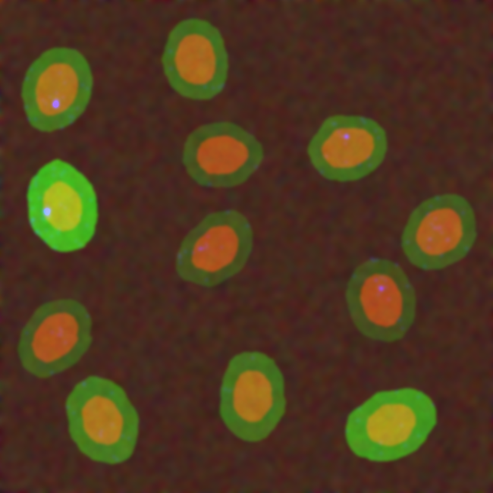
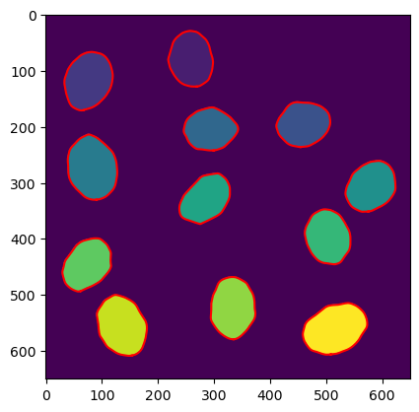
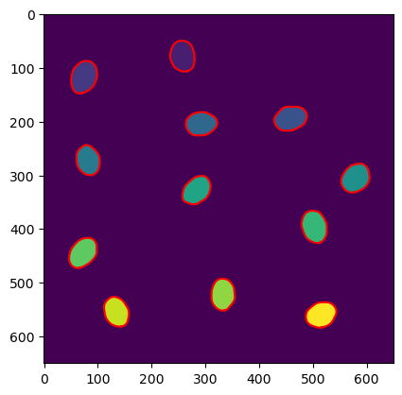
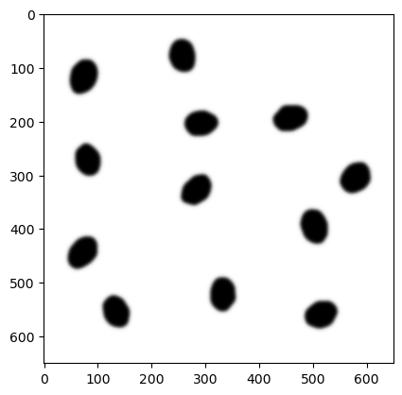
Steps to get the csv file with the data for each drug:
Apply Gaussian filter to the image
Histogram visualization of the data
Select a threshold value
Apply Watershed to differenciate the cells
Apply region prop function to calculate the parameters: numbers of cells, cell and nuclei size, intensity, etc.

Slide 5
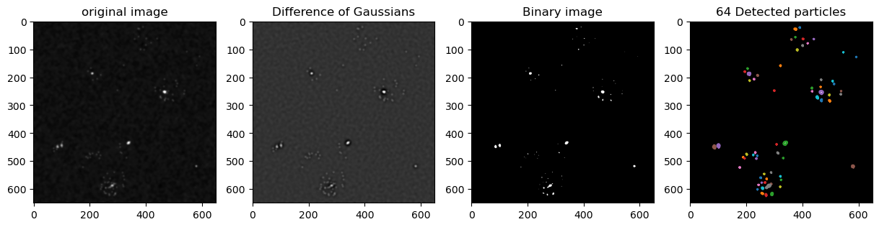
Steps to get the csv file with the data for each drug:
Load the masks and labels unique cells
Load the original images
Separate the blue channel
Apply Gaussian filter to the image and binarize it
Label and counts RNA spots within the nucleus and cytoplasm for each cell across all frames, storing the counts in a csv file.

Slide 6
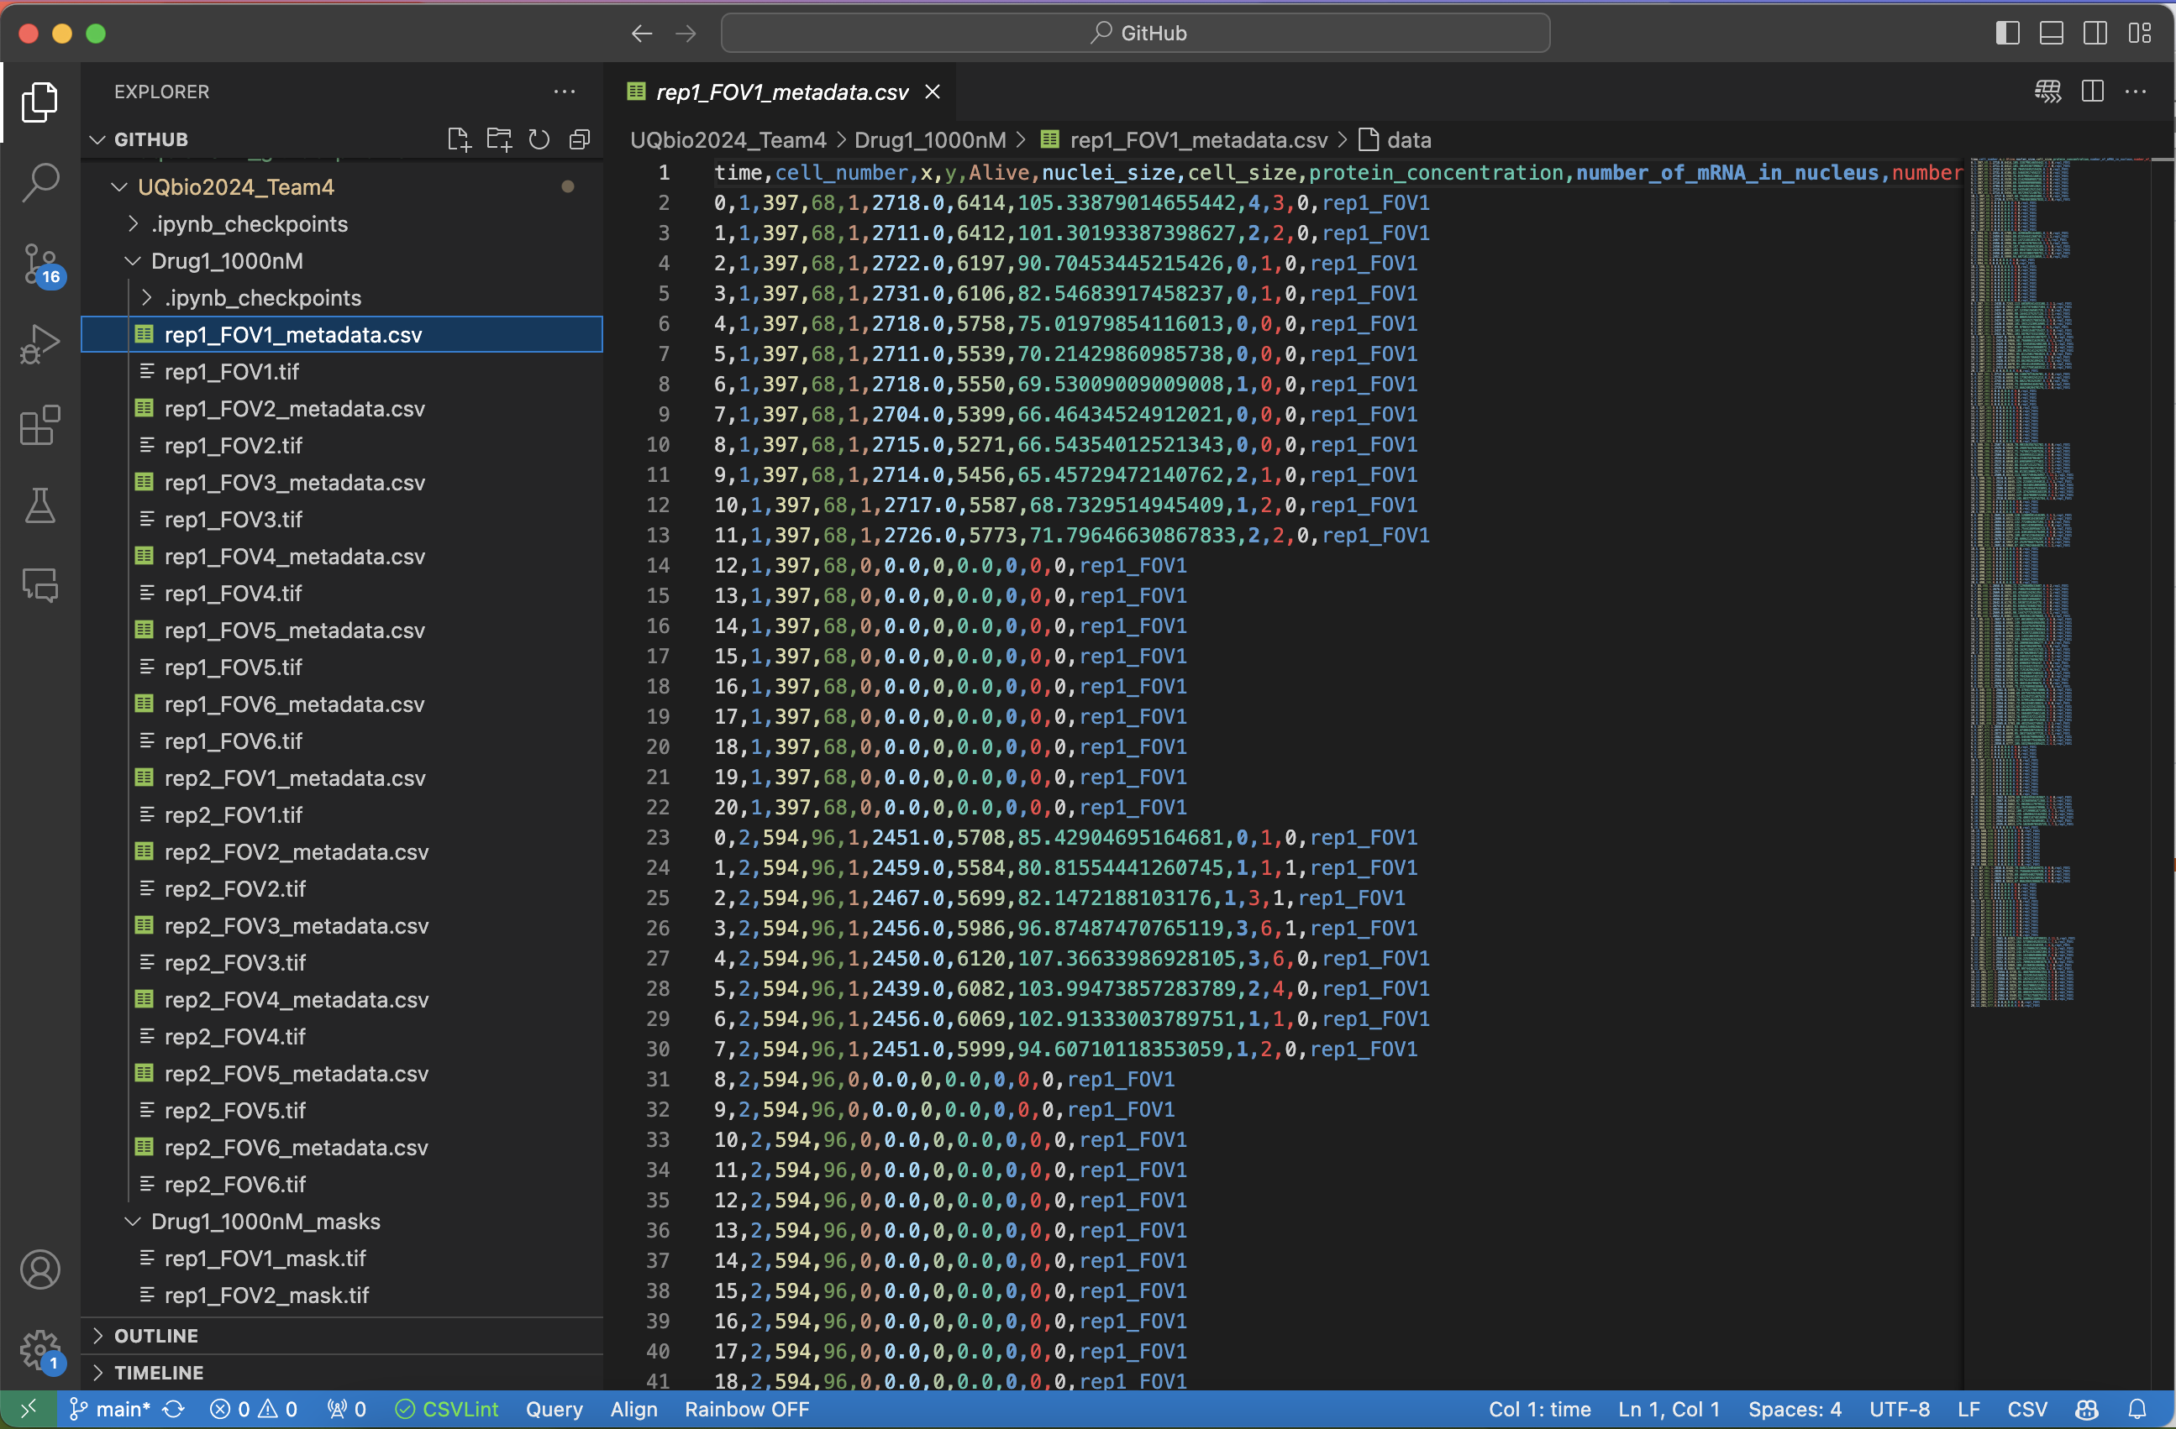

Slide 7
Stage 2: Statistic Analysis

Slide 8
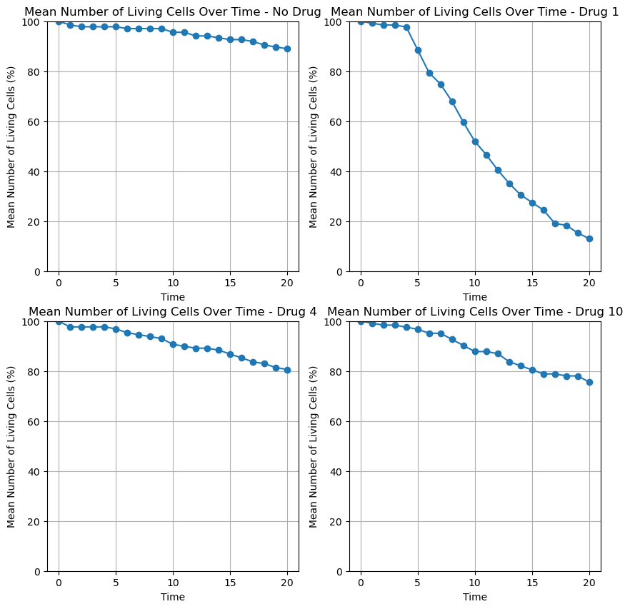
Vitality
No drug
Drug 1
Drug 4
Drug 10

Slide 9
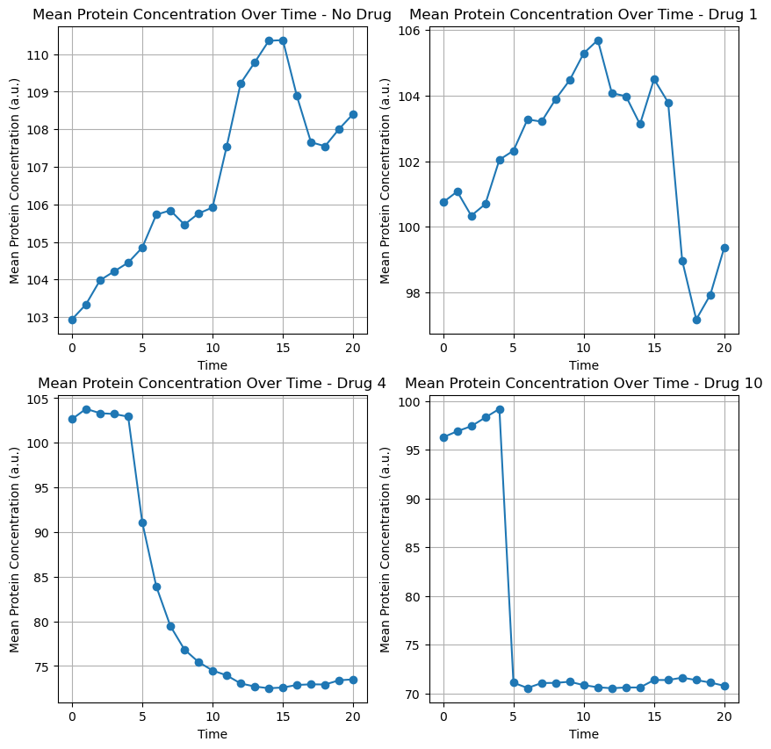
No drug
Drug 1
Protein
concentration
Drug 4
Drug 10

Slide 10
Potential Drugs
Drug
2
Drug
4
Drug
6
Drug
7
Drug
8

Slide 11
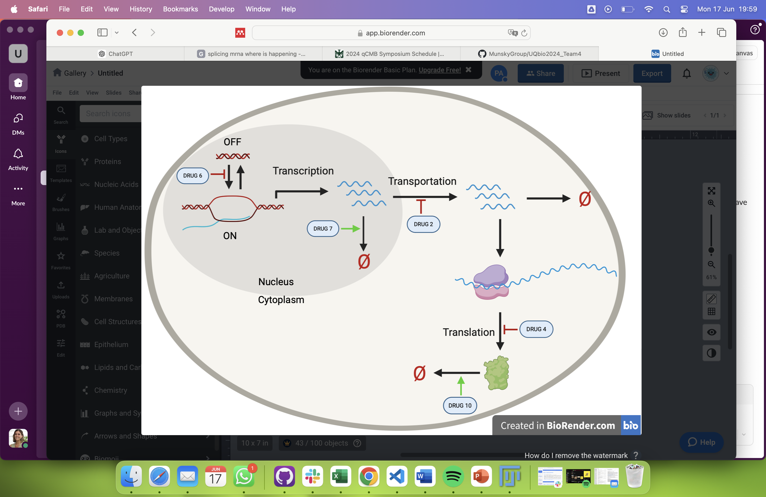
Proposed model

Slide 12
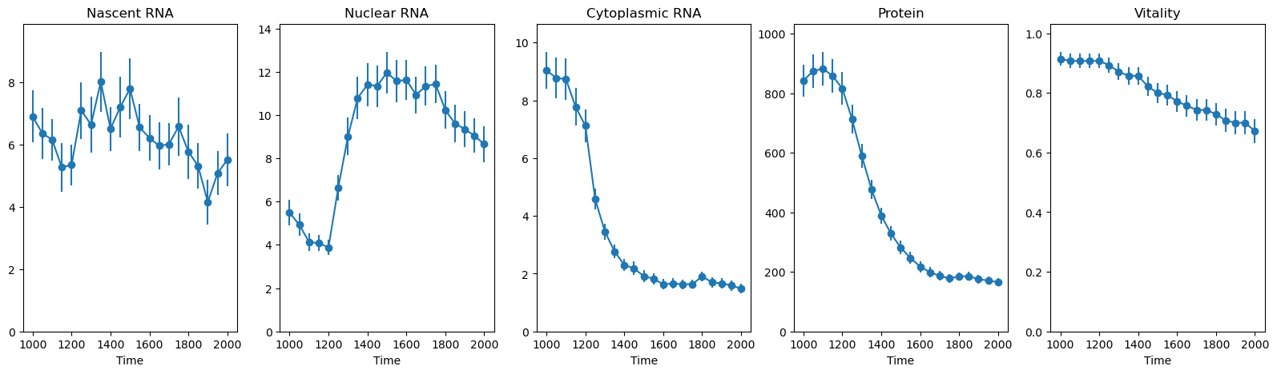
Drug 2

Slide 13
Drug 4

Slide 14
Drug 6

Slide 15
Drug 7

Slide 16
Drug 10

Slide 17
Stages 3 and 4: Model Generation, Paramerization and Desing

Slide 18
Pre-selection of Drugs concentrations
DRUG | 100nM | 300nM | 1000nM | 3000nM | 10000nM
Drug2 | OK | OK | OK | ----------------- | -----------------
Drug4 | OK | OK | OK | ----------------- | -----------------
Drug6 | OK | OK | OK | ----------------- | -----------------
Drug7 | OK | OK | OK | OK (50% vit) | -----------------
Drug10 | OK | OK | OK | ----------------- | -----------------
__ PROTEIN NOT AFFECTED OK: vitality > 20%

Slide 19
Model Plots

Slide 20
DRUG | CONCENTRATION | TIME
2
4
6
7
10
Best conditios

Slide 21
Final decision

